Slide 1
Graph of Straight Lines and Quadratic Functions
Mrs. Parami Wattetenne
Lecturer (Probationary)
Department of Multidisciplinary Studies
Faculty of Technology
University of Ruhuna

Slide 2
Topic Covered
Cartesian X-Y plane
Straight Line Equations
Graph of Straight Lines
Qudratic Functions
Graph of Qudratic Functions
Maximum and Minimum Values
System of Linear Equations

Slide 3
Systems of linear equations
Linear simultaneous equations in two unknowns may be solved graphically by:
  (i) plotting the two straight lines on the same axes, and
  (ii) noting their point of intersection.
The co-ordinates of the point of intersection give the required solution.

Slide 4
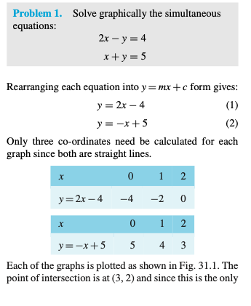
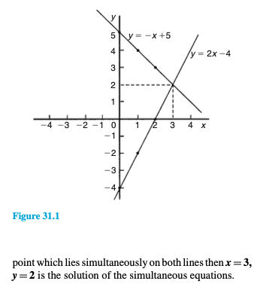
Systems of linear equations

Slide 5
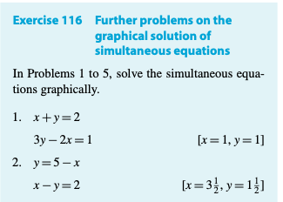
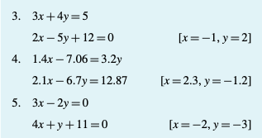
Systems of linear equations

Slide 6
Graphical solutions of linear and quadratic equations
The solution of linear and quadratic equations simul- taneously may be achieved graphically by:
  (i) plotting the straight line and parabola on the same axes
  (ii) noting the points of intersection.
The co-ordinates of the points of intersection give the required solutions.

Slide 7


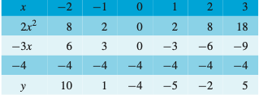


Graphical solutions of linear and quadratic equations
$$y=2−4x$$
Draw$y={2x}^{2}−3x−4$

Slide 8
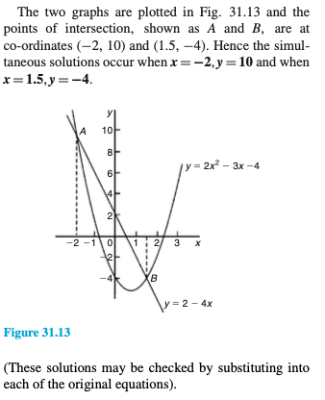
Graphical solutions of linear and quadratic equations

Slide 9
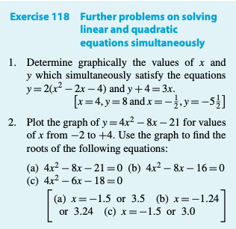
Graphical solutions of linear and quadratic equations

Slide 10
Thank You

